Slide 1
Strategic Leadership
607MAN 303MAN
Managing Strategic Change
Week 1 – Session 3

Slide 2



What we’re going to cover today…
(1)
What is strategic change?
(2)
Developing
a strategic
change program
(3)
Nature of strategic
change

Slide 3
Session Outcomes
Evaluate and apply conceptual and practical approaches to strategic leadership in a range of different organisational settings.
Analyse contemporary research on the role of leadership in managing change.
Critically assess the relevance of leadership styles to key sector changes including globalisation, internationalisation, strategy, technological innovation and organisation development.
Identify and critically reflect on leadership capabilities and strategies of key Business leaders across a range of sectors.
Evaluate an incident of strategic organisational change by exploring the role of leadership and the measurement and management of Key Performance Indicators (KPI’s).
Critically explore the ethical relationships between leaders and followers in relation to decision making, corporate governance and policy practices in organisations.

Slide 4
CMI Definition of Change Management
The co-ordination of a structured period of transition from situation A to situation B to achieve lasting change within an organisation. It can vary in scope, from continuous improvement - small ongoing changes to existing processes - to radical and substantial change involving organisational strategy.
Change management can be reactive or proactive - instigated in reaction to something in an organisation's external environment, for example in the realms of economics, politics, legislation or competition, or in reaction to something within the processes, structures, people and events of the organisation's internal environment.
Or a proactive measure, for example in anticipation of future unfavourable economic conditions
Change management usually follows five steps:
recognition of a trigger indicating that change is needed;
clarification of the end point, or where we want to be;
planning how to achieve the change;
accomplishment of the transition;
maintenance to ensure the change is lasting.
Effective change management involves personal alterations, for example a shift in attitudes or work routines. Personnel management skills such as motivation are vital.
Other important influences on success of change management include leadership style, communication, and a unified positive attitude to the change among the workforce.

Slide 5

Prescriptive and Emergent approaches to Managing Strategic Change
Strategic change is the pro-active management of change in an organisation to achieve clearly identified strategic objectives
Implementation actions that result from the decision to pursue a chosen strategy
Such change may possibly be imposed on those who have to implement it
Often winners and losers among managers: some welcome change and some fight against it
Keypoint: how do you manage strategic change? Both prescriptive and emergent approaches

Slide 6
Prescriptive and Emergent approaches to Managing Strategic Change
Prescriptive approaches to managing strategic change:
Emphasise the need for sudden change – possibly a revolution at an organisation
Lewin’s change model
Emergent approaches to managing strategic change:
Emphasise a more gradual approach to change – evolution rather than revolution
Continuous learning approach based on work by Pettigrew and Whipp, Senge, Quinn and others
Notes:
See: Lynch Ch 15 for fuller treatment

Slide 7
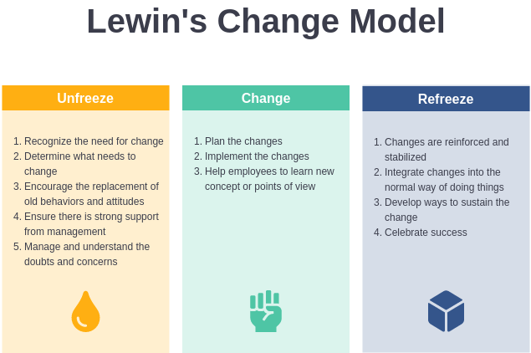
Prescriptive approaches to Managing Strategic Change
Lewin Change Model
1. Unfreezing current attitudes
Old behaviour is seen as unsatisfactory and needs change.
2. Moving to a new level
Search for new solutions
3. Refreezing attitudes at the new level
Only when a satisfactory solution found
May involve positive re-enforcement and support for decisions taken

Slide 8
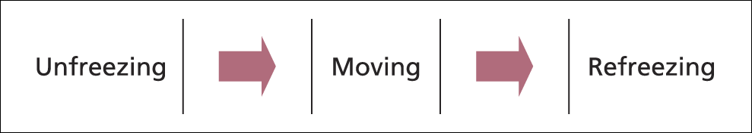
Lewin’s (1947) Three-Step Model of Change
Unfreezing the behaviour
Create dissatisfaction with the existing situation.
Create a willingness to change.
Moving the behaviour
Identify and implement change.
Involve people.
Refreezing behaviour
Take steps to stabilise and reinforce the change.
Maintain the momentum
Joint goal-setting
Feedback
Rewards.
Notes:
Figure 9.3

Slide 9
Prescriptive and Emergent approaches to Managing Strategic Change
Emergent approaches to managing change ‘start’ as the strategy is still being developed: involving, consulting, discussing the implications of a new strategy before it is finalised
Contrast this with the prescriptive approach which considers strategic change after the strategy has been developed
Emergent approaches are considered to occur continuously in an organisation with no sudden changes
Emergent change process is therefore more evolutionary in its impact than prescriptive change

Slide 10
The continuous learning emergent approach – Pettigrew and Whipp and Senge.
Starts from the position that the organisation does not suddenly adopt strategic change but is perpetually seeking it
Process of learning is continuous: as one area is learnt, so new avenues of experimentation and communication open up
No sudden, specific ‘change project’

Slide 11
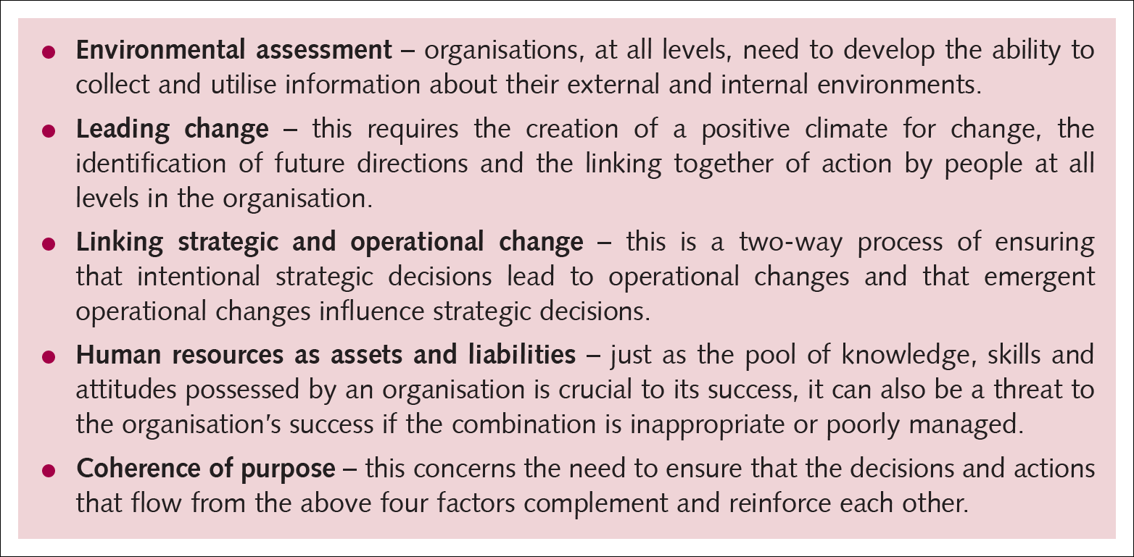
Five central factors for managing change
Source: Pettigrew and Whipp (1993).

Slide 12
Four areas of competence for leaders: from Bennis and Nanus:
Vision
Communications
Trust
Self-knowledge
Two other possible areas of competence:
Responsiveness to the situation
Creativity

Slide 13
The Continuous Learning Emergent Approach (Senge 1990)
The learning approach emphasises:
Team learning
The sharing of views and visions for the future
The exploration of ingrained company habits
People skills as the most important asset of the organisation
Systems thinking: the integrative area that supports the four above and provides the basis for viewing the environment

Slide 14
Developing a Strategic Change Programme
Importantly, this will begin by examining the organisation, its culture and leadership style
For example:
Centrally-directed management style might emphasise the organisational work and formal distribution of power
Open-learning, empowerment management style might emphasise team building, training and education
No universal answers: examine the leadership and culture of the organisation for indicators on choice – perhaps even the leader needs to change

Slide 15
Developing a Strategic Change Programme
Strategic change programme needs to address five basic questions:
What is the purpose of the change?
What areas of change are available?
What areas will we select and why?
Will people resist change? If so, how can this be overcome?
Do we need to change the culture of the organisation? If yes, then this will be a slow process

Slide 16
Developing a strategic change programme
We can use either the prescriptive or the emergent approaches to develop a strategic change programme: these are mutually exclusive because of their totally different approaches to the nature of change
Choice depends primarily on the strategic context:
Prescriptive when there is a need for rapid fix and sudden change or when organisational culture expects such an aggressive approach
Emergent when organisational culture is more open and time is available to allow the change to develop

Slide 17
Nature of Strategic Change
Prescriptive approaches to strategic change
Implementation actions that result from the decision to pursue a chosen strategy
Such change may possibly be imposed on those who have to implement it
Emergent approaches to strategic change
Whole process of developing the strategy in addition to the actions that result once the strategy has been developed
Such change may involve experimentation, learning and consultation among those involved in the change

Slide 18
Four main causes of strategic change – Tichy (1983)
Environment: economy, competition, etc.
Business relationships: alliances, acquisitions, etc.
Technology
People: new leadership, new entrants to the organisation, etc.

Slide 19
Team activity – 40 minutes
Based on Tichy’s causes of strategic change, identify, at least two companies, who have gone through the types of change mentioned. Provide details of the change – what happened? What was the outcome?

Slide 20
Three dynamics for strategic change - Kanter, Stein and Jick (1992)
Environment
Lifecycle differences: different parts of the organisation at different stages of lifecycle, so different sizes, shapes and resource allocation needs
Political power changes inside the organisation: individuals, groups and stakeholders struggle for power
Notes:
Key point: need to explore and define more precisely for the organisation concerned

Slide 21
What we’ve covered today…
(1)
What is strategic change?
(2)
Developing a
strategic
change
program
(3)
Nature of strategic
change

Slide 22

Traffic Light it
Where is your learning at?
Red = I have misunderstood some of the topics. (write down 2 questions that you need help with)
Amber = I have understood most of the topics so far (write down 1 question and 1 key theme you have understood)
Green = I have understood the topics so far (write down 2 key themes from the lesson to show your understanding)

Slide 23

Reading list
Essential Reading
Lynch, R., (2021) Strategic Management. 9th edn. London: Pearson Education
Yukl, G. (2020), Leadership in Organizations: Global Edition. 9th edn. Los Angeles: SAGE
Recommended Reading
Robbins, S.P., De Cenzo, D.A., Coulter, M. (2020) Fundamentals of Management: Management Myths Debunked! Global Edition. 11th edn. Harlow: Pearson
Johnson, G., Whittington R., Scholes K. (2020) Exploring Strategy: Texts and Cases. 12th edn. Harlow: Pearson.

